Slide 1
Chapter 5 Class Design
By: Omar Mahmoud

Slide 2

Introducing Class Inheritance Creating Abstract Classes Implementing Interfaces Understanding Polymorphism

Slide 3
Inheritance in Java allows classes to inherit properties and methods from other classes.
Inheritance creates a parent-child relationship between classes.
Child classes inherit public and protected members from their parent classes.
Java supports single inheritance, by which a class may inherit from only one direct parent class. Java also supports multiple levels of inheritance, by which one class may extend another class, which in turn extends another class.
You can extend a class any number of times .

Slide 4
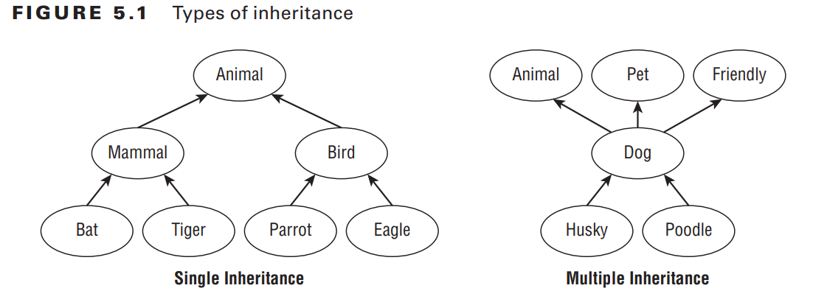
Types of Inheritance:
Child classes inherit from parent classes.
Terminology: Child class, descendant, parent class, ancestor.
Single inheritance: A class can inherit from only one direct parent class.
Multiple levels of inheritance are supported, allowing chains of ancestors.
Java doesn't support multiple inheritance (with exceptions for interfaces).).

Slide 5
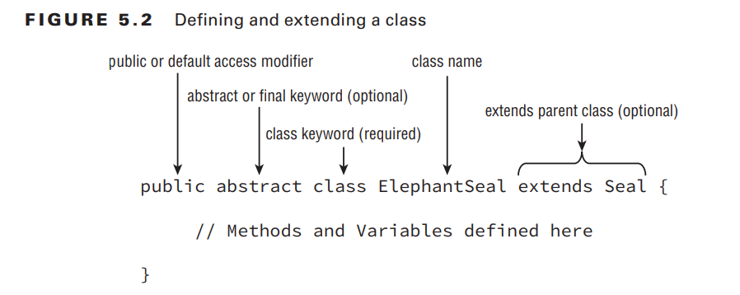
In Java, you can extend a class by adding the parent class name in the definition using the extends keyword.

Slide 6
public class Animal
{
private int age;
public int getAge()
{
return age;
}
public void setAge(int age)
{
this.age = age;
}
}
public class Lion extends Animal
{
private void roar()
{
System.out.println("The "+getAge()+" year old lion says: Roar!");
}
}
Assuming they are in the same package.

Slide 7
All classes in Java inherit from java.lang.Object.
Compiler automatically adds extends java.lang.Object to classes without a parent.
Parent constructors are called before child constructors.

Slide 8
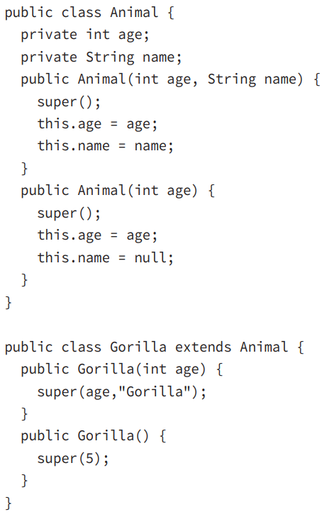
Constructors call other constructors using this() or super().
super() must be the first statement in a constructor.
Compiler inserts super() if no call to parent constructor exists.
Child classes must explicitly call parent constructors if the parent doesn't have a no-arg constructor.

Slide 9

Constructor Definition Rules in Class Inheritance
The first statement in every constructor:
Calls another constructor within the same class using this().
Calls a constructor in the direct parent class using super().
First Constructor Statement:
Restrictions on super():
super() call must be the first statement in the constructor.
Implicit super():
If no super() is specified in a constructor, Java adds a default no-argument super().
Parent's No-Argument Constructor:
If the parent lacks a no-argument constructor:
Child class must provide constructors explicitly.
Compiler attempts to insert a default no-argument constructor in the child.
If parent lacks no-argument constructor:
Child constructors must explicitly call a parent constructor.
Ensures proper initialization in child class.
Explicit Parent Constructor Call:

Slide 10
public class Vehicle {
private String type;
public Vehicle(String type) {
this.type = type;
}
}
public class Car extends Vehicle {
private int wheels;
public Car(String type, int wheels) {
super(type); // Calling parent constructor
this.wheels = wheels;
}
}
public class Animal {
public Animal() {
System.out.println("Animal constructor");
}
}
public class Mammal extends Animal {
public Mammal() {
System.out.println("Mammal constructor");
super();
// Error: super() must be the first statement
}
}
public class Parent {
public Parent() {
System.out.println("Parent constructor");
}
}
public class Child extends Parent {
// Compiler adds: super(); implicit call
public Child() {
System.out.println("Child constructor");
}
}

Slide 11
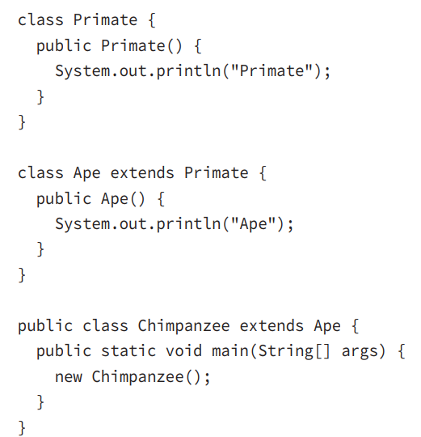
Calling Constructors
determine what the following code outputs:
Primate
Ape

Slide 12

Accessing Members in Class Inheritance
Java classes can access members of their parent classes.
Accessible members include:
Public and protected members.
Methods, primitives, and object references.
When parent and child classes are in the same package:
Child classes can access parent's default members.
Child classes can access parent's public and protected members.
Child classes cannot directly access private members of parent classes.
Private members are only accessible within their declaring class.
Indirect access to private members can be achieved through public or protected methods.

Slide 13

class Fish {
protected int size;
private int age;
public Fish(int age) {
this.age = age;
}
public int getAge() {
return age;
}
}
public class Shark extends Fish {
private int numberOfFins = 8;
public Shark(int age) {
super(age);
this.size = 4;
}
public void displaySharkDetails() {
System.out.print("Shark with age: " + getAge());
System.out.print(" and " + size + " meters long");
System.out.print(" with " + numberOfFins + " fins");
}
}

Slide 14
super() vs. super
The first, super(), is a statement that explicitly calls a parent constructor and may only be used in the fi rst line of a constructor of a child class. The second, super, is a keyword used to reference a member defi ned in a parent class and may be used throughout the child class
public Rabbit(int age)
{
super();
super.setAge(10);
}

Slide 15

Method Overriding in Inheritance
Overriding a Method: When a method is defined in both parent and child classes, you can create a new version in the child class that uses the parent's definition.
Method Signature: The overriding method must have the same method signature (name and parameter list) as the parent method.
Access Modifiers: The overriding method must be at least as accessible as the parent method.
Exception Handling: The overriding method can't throw new or broader checked exceptions than the parent method.
Return Type: If the method returns a value, the return type must be the same or a subclass of the parent method's return type (covariant return types).

Slide 16
class Canine {
public double getAverageWeight() {
return 50;
}
}
class Wolf extends Canine {
public double getAverageWeight() {
return super.getAverageWeight() + 20;
}
}
public class MethodOverrideExample {
public static void main(String[] args) {
Canine canine = new Canine();
System.out.println(canine.getAverageWeight()); // Output: 50.0
Wolf wolf = new Wolf();
System.out.println(wolf.getAverageWeight()); // Output: 70.0
}
}

Slide 17
Overloading vs. Overriding
public class Bird {
public void fly() {
System.out.println("Bird is flying");
}
public void eat(int food) {
System.out.println("Bird is eating " + food + " units of food");
}
}
public class Eagle extends Bird {
public int fly(int height) {
System.out.println("Bird is flying at " + height + " meters");
return height;
}
public int eat(int food) {
System.out.println("Bird is eating " + food + " units of food");
return food;
}
}
Overloading a method and overriding a method are similar in that they both involve redefining a method using the same name. They differ in that an overloaded method will use a different signature than an overridden method. This distinction allows overloaded methods a great deal more freedom in syntax than an overridden method would have.

Slide 18
Examples: will Compile or not ? Why ?
public class Camel {
protected String getNumberOfHumps() {
return "Undefined";
}
}
public class BactrianCamel extends Camel {
// The following method won't compile due to an access modifier issue
private int getNumberOfHumps() {
return 2;
}
}
public class InsufficientDataException extends Exception {}
public class Reptile {
protected double getHeight() throws InsufficientDataException {
return 2;
}
protected int getLength() {
return 10;
}
}
public class Snake extends Reptile {
// Does Not Compile
protected double getHeight() throws Exception {
return 2;
}
// Does Not Compile
protected int getLength() throws InsufficientDataException {
return 10;
}
}

Slide 19
Hiding Static Methods
A hidden method occurs when a child class defines a static method with the same name and signature as a static method defined in a parent class.
Same rules for overriding method.
++
The method defined in the child class must be marked as static if it is marked as static in the parent class (method hiding). Likewise, the method must not be marked as static in the child class if it is not marked as static in the parent class (method overriding).

Slide 20
Examples
public class Bear {
public static void sneeze() {
System.out.println("Bear is sneezing");
}
public void hibernate() {
System.out.println("Bear is hibernating");
}
}
public class Panda extends Bear {
// The following method won't compile due to an attempted override of a static method
public void sneeze() {
System.out.println("Panda bear sneezes quietly");
}
// The following method won't compile due to an attempted override of a non-static method
public static void hibernate() {
System.out.println("Panda bear is going to sleep");
}
}
public class Bear {
public static void eat() {
System.out.println("Bear is eating");
}
}
public class Panda extends Bear {
public static void eat() {
System.out.println("Panda bear is chewing");
}
public static void main(String[] args) {
Panda.eat();
}
}

Slide 21
Overriding vs. Hiding Methods
public class Marsupial { public static boolean isBiped() { return false; } public void getMarsupialDescription() { System.out.println("Marsupial walks on two legs: " + isBiped()); } } public class Kangaroo extends Marsupial { public static boolean isBiped() { return true; } public void getKangarooDescription() { System.out.println("Kangaroo hops on two legs: " + isBiped()); } public static void main(String[] args) { Kangaroo joey = new Kangaroo(); joey.getMarsupialDescription(); joey.getKangarooDescription(); } }
class Marsupial { public boolean isBiped() { return false; } public void getMarsupialDescription() { System.out.println("Marsupial walks on two legs: "+isBiped()); } } public class Kangaroo extends Marsupial { public boolean isBiped() { return true; } public void getKangarooDescription() { System.out.println("Kangaroo hops on two legs: "+isBiped()); } public static void main(String[] args) { Kangaroo joey = new Kangaroo(); joey.getMarsupialDescription(); joey.getKangarooDescription(); } }
Marsupial walks on two legs: false Kangaroo hops on two legs: true
Marsupial walks on two legs: true Kangaroo hops on two legs: true

Slide 22
Creating final methods
public class Bird { public final boolean hasFeathers() { return true; } } public class Penguin extends Bird { public final boolean hasFeathers() {
// DOES NOT COMPILE return false; } }
In this example, the method hasFeathers() is marked as final in the parent class Bird, so the child class Penguin cannot override the parent method, resulting in a compiler error. Note that whether or not the child method used the final keyword is irrelevant—the code will not compile either way.

Slide 23
Hiding Variables
public class Rodent { protected int tailLength = 4; public void getRodentDetails() { System.out.println("[parentTail="+tailLength+"]"); } } public class Mouse extends Rodent { protected int tailLength = 8; public void getMouseDetails() { System.out.println("[tail="+tailLength +",parentTail="+super.tailLength+"]"); } public static void main(String[] args) { Mouse mouse = new Mouse(); mouse.getRodentDetails(); mouse.getMouseDetails(); } }
This creates two copies of the variable within an instance of the child class: one instance defi ned for the parent reference and another defined for the child reference.
[parentTail=4]
[tail=8,parentTail=4]

Slide 24
Creating Abstract Classes
Let’s say you want to define a parent class that other developers are going to subclass. Your goal is to provide some reusable variables and methods to developers in the parent class, whereas the developers provide specific implementations or overrides of other methods in the child classes. Furthermore, let’s say you also don’t want an instance of the parent class to be instantiated unless it is an instance of the child class.
public abstract class Animal { protected int age; public void eat() { System.out.println("Animal is eating"); } public abstract String getName(); } public class Swan extends Animal { public String getName() { return "Swan"; } }

Slide 25
Examples:
public class Chicken { public abstract void peck();
// DOES NOT COMPILE }
public abstract class Turtle { public abstract void swim() {} // DOES NOT COMPILE public abstract int getAge() { // DOES NOT COMPILE return 10; } }
an abstract class cannot be marked as final
a method may not be marked as both abstract and private.
public final abstract class Tortoise { // DOES NOT COMPILE }
public abstract class Whale { private abstract void sing(); // DOES NOT COMPILE }

Slide 26
abstract classes can extend other abstract classes and are not required to provide implementations for any of the abstract methods.
public abstract class Animal { public abstract String getName(); } public class Walrus extends Animal { // DOES NOT COMPILE } public abstract class Eagle extends Animal { }
There is one exception to the rule for abstract methods and concrete classes: a concrete subclass is not required to provide an implementation for an abstract method if an intermediate abstract class provides the implementation.
public abstract class Animal { public abstract String getName(); } public abstract class BigCat extends Animal { public String getName() { return "BigCat"; } public abstract void roar(); } public class Lion extends BigCat { public void roar() { System.out.println("The Lion lets out a loud ROAR!"); } }

Slide 27

Abstract Class Definition Rules:
1. Abstract classes cannot be instantiated directly.
2. Abstract classes may be defined with any number, including zero, of abstract and nonabstract methods.
3. Abstract classes may not be marked as private or final.
4. An abstract class that extends another abstract class inherits all of its abstract methods as its own abstract methods.
5. The first concrete class that extends an abstract class must provide an implementation for all of the inherited abstract methods.
Abstract Method Definition Rules:
1. Abstract methods may only be defined in abstract classes.
2. Abstract methods may not be declared private or final.
3. Abstract methods must not provide a method body/implementation in the abstract class for which is it declared.
4. Implementing an abstract method in a subclass follows the same rules for overriding a method. For example, the name and signature must be the same, and the visibility of the method in the subclass must be at least as accessible as the method in the parent class.

Slide 28
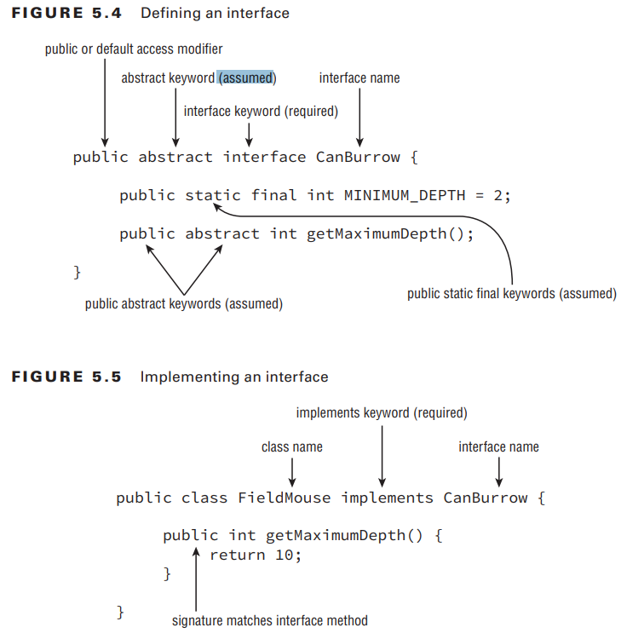
Implementing Interfaces
Although Java doesn’t allow multiple inheritance, it does allow classes to implement any number of interfaces. An interface is an abstract data type that defines a list of abstract public methods that any class implementing the interface must provide.
A class may implement multiple interfaces, each separated by a comma, such as in the following example:
public class Elephant implements WalksOnFourLegs, HasTrunk, Herbivore { }

Slide 29
Defining an Interface
1. Interfaces cannot be instantiated directly.
2. An interface is not required to have any methods.
3. An interface may not be marked as final.
4. All top-level interfaces are assumed to have public or default access, and they must include the abstract modifier in their definition. Therefore, marking an interface as private, protected, or final will trigger a compiler error, since this is incompatible with these assumptions.
5. All non-default methods in an interface are assumed to have the modifiers abstract and public in their definition. Therefore, marking a method as private, protected, or final will trigger compiler errors as these are incompatible with the abstract and public keywords.

Slide 30
Defining an Interface
the compiler inserting a default no-argument constructor or super() statement into your constructor. You may provide these modifi ers yourself, although the compiler will insert them automatically if you do not. For example, the following two interface defi nitions are equivalent, as the compiler will convert them both to the second example: public interface CanFly { void fly(int speed); abstract void takeoff(); public abstract double dive(); } public abstract interface CanFly { public abstract void fly(int speed); public abstract void takeoff(); public abstract double dive(); }
private final interface CanCrawl { // DOES NOT COMPILE private void dig(int depth); // DOES NOT COMPILE protected abstract double depth(); // DOES NOT COMPILE public final void surface(); // DOES NOT COMPILE } Every single line of this example doesn’t compile. The fi rst line doesn’t compile for two reasons. First, it is marked as final, which cannot be applied to an interface since it conflicts with the assumed abstract keyword. Next, it is marked as private, which conflicts with the public or default required access for interfaces. The second and third line do not compile because all interface methods are assumed to be public and marking them as private or protected throws a compiler error. Finally, the last line doesn’t compile because the method is marked as final and since interface methods are assumed to be abstract, the compiler throws an exception for using both abstract and final keywords on a method.

Slide 31
Inheriting an Interface
public interface HasTail { public int getTailLength(); } public interface HasWhiskers { public int getNumberOfWhiskers(); } public interface Seal extends HasTail, HasWhiskers { }
Any class that implements the Seal interface must provide an implementation for all methods in the parent interfaces—in this case, getTailLength() and getNumberOfWhiskers().
1. An interface that extends another interface, as well as an abstract class that implements an interface, inherits all of the abstract methods as its own abstract methods.
2. The first concrete class that implements an interface, or extends an abstract class that implements an interface, must provide an implementation for all of the inherited abstract methods

Slide 32
Inheriting an Interface
public interface HasTail { public int getTailLength(); } public interface HasWhiskers { public int getNumberOfWhiskers(); } public abstract class HarborSeal implements HasTail, HasWhiskers { } public class LeopardSeal implements HasTail, HasWhiskers { // DOES NOT COMPILE }

Slide 33
Default Methods and Multiple Inheritance
public interface Walk { public default int getSpeed() { return 5; } } public interface Run { public default int getSpeed() { return 10; } } public class Cat implements Walk, Run {
// DOES NOT COMPILE public static void main(String[] args) { System.out.println(new Cat().getSpeed()); } }
You may have realized that by allowing default methods in interfaces, coupled with the fact a class may implement multiple interfaces, Java has essentially opened the door to multiple inheritance problems. For example, what value would the following code output?

Slide 34
Static Interface Methods
Like all methods in an interface, a static method is assumed to be public and will not compile if marked as private or protected.
2. To reference the static method, a reference to the name of the interface must be used.
public interface Hop { static int getJumpHeight() { return 8; } } public class Bunny implements Hop { public void printDetails() { System.out.println(getJumpHeight());
// DOES NOT COMPILE } }
public class Bunny implements Hop { public void printDetails() { System.out.println(Hop.getJumpHeight()); } }

Slide 35
Understanding Polymorphism
Java supports polymorphism, the property of an object to take on many different forms. To put this more precisely, a Java object may be accessed using a reference with the same type as the object, a reference that is a superclass of the object, or a reference that defines an interface the object implements, either directly or through a superclass. Furthermore, a cast is not required if the object is being reassigned to a super type or interface of the object.

Slide 36
Examples :
class Animal { public void animalSound() { System.out.println("The animal makes a sound"); } } class Pig extends Animal { public void animalSound() { System.out.println("The pig says: wee wee"); } } class Dog extends Animal { public void animalSound() { System.out.println("The dog says: bow wow"); } }
class Main { public static void main(String[] args) { Animal myAnimal = new Animal(); // Create a Animal object Animal myPig = new Pig(); // Create a Pig object Animal myDog = new Dog(); // Create a Dog object myAnimal.animalSound(); myPig.animalSound(); myDog.animalSound(); } }

Slide 37
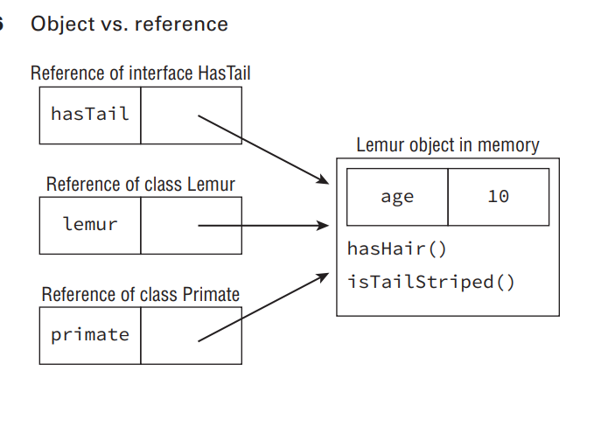
Object vs. Reference
In Java, all objects are accessed through references, never directly.
Conceptually, an object is a memory entity managed by the Java runtime.
An object's type determines its properties in memory.
A reference's type determines accessible methods and variables.
Changing a reference type doesn't change the object, just our access.

Slide 38
Casting Objects
Typecasting is the assessment of the value of one primitive data type to another type. In java.
1. Casting an object from a subclass to a superclass doesn’t require an explicit cast.
2. The compiler will not allow casts to unrelated types.
3. Even when the code compiles without issue, an exception may be thrown at runtime if the object being cast is not actually an instance of that class.
Superclass variable = new Subclass object(); (Superclass variable).method();

Slide 39
Virtual Methods
public class Bird { public String getName() { return "Unknown"; } public void displayInformation() { System.out.println("The bird name is: "+getName()); } } public class Peacock extends Bird { public String getName() { return "Peacock"; } public static void main(String[] args) { Bird bird = new Peacock(); bird.displayInformation(); } }
The most important feature of polymorphism—and one of the primary reasons we have class structure at all—is to support virtual methods. A virtual method is a method in which the specific implementation is not determined until runtime. In fact, all non-final, nonstatic, and non-private Java methods are considered virtual methods, since any of them can be overridden at runtime. What makes a virtual method special in Java is that if you call a method on an object that overrides a method, you get the overridden method, even if the call to the method is on a parent reference or within the parent class.
The bird name is: Peacock

Slide 40
Polymorphic Parameters
One of the most useful applications of polymorphism is the ability to pass instances of a subclass or interface to a method. For example, you can defi ne a method that takes an instance of an interface as a parameter. In this manner, any class that implements the interface can be passed to the method. Since you’re casting from a subtype to a supertype, an explicit cast is not required. This property is referred to as polymorphic parameters of a method, and we demonstrate it in the following example:
public class Reptile { public String getName() { return "Reptile"; } } public class Alligator extends Reptile { public String getName() { return "Alligator"; } } public class Crocodile extends Reptile { public String getName() { return "Crocodile"; } } public class ZooWorker { public static void feed(Reptile reptile) { System.out.println("Feeding reptile "+reptile.getName()); } public static void main(String[] args) { feed(new Alligator()); feed(new Crocodile()); feed(new Reptile()); } }
This code compiles and executes without issue, yielding the following output: Feeding: Alligator
Feeding: Crocodile
Feeding: Reptile

Slide 41
Polymorphism and Method Overriding
Let’s conclude this chapter by returning to the last three rules for method overriding to demonstrate how polymorphism requires them to be included as part of the Java specification.
The first rule is that an overridden method must be at least as accessible as the method it is overriding.
public class Animal { public String getName() { return "Animal"; } } public class Gorilla extends Animal { protected String getName() {
//Doesn’t compile return "Gorilla"; } } public class ZooKeeper { public static void main(String[] args) { Animal animal = new Gorilla(); System.out.println(animal.getName()); }

Slide 42
2. Exception Handling:
class Animal {
void makeSound() throws Exception {
// Some code
}
}
class Dog extends Animal {
// Not allowed: Broadening the exception type
@Override
void makeSound() throws Exception {
// Some code that might throw a more specific exception
}
}
In this case, the compiler won't allow the subclass Dog to declare a broader exception because if we call makeSound() using an Animal reference, the compiler wouldn't know about the more specific exception thrown in the overridden method in Dog

Slide 43
3. Return Types:
class NumberHolder {
Number getNumber() {
return null;
}
}
class IntegerHolder extends NumberHolder {
// Not allowed: Covariant return type, changing to a more specific type
@Override
Integer getNumber() {
return null;
}
}
In this example, the Java compiler won't allow the return type of the overridden method in IntegerHolder to be Integer, even though Integer is a subclass of Number. This is because if we call getNumber() using a NumberHolder reference, we would expect a Number but would actually get an Integer.

Slide 44
Questions..
1. What modifiers are implicitly applied to all interface methods? (Choose all that apply)
A. protected B. public C. static D. void E. abstract F. default
(B,E)
2. Which of the following may only be hidden and not overridden? (Choose all that apply)
A. private instance methods B. protected instance methods C. public instance methods D. static methods E. public variables F. private variables
(A, D, E, F)

Slide 45
4. What is the output of the following code? 1: interface Nocturnal { 2: default boolean isBlind() { return true; } 3: } 4: public class Owl implements Nocturnal { 5: public boolean isBlind() { return false; } 6: public static void main(String[] args) { 7: Nocturnal nocturnal = (Nocturnal)new Owl(); 8: System.out.println(nocturnal.isBlind()); 9: } 10: } A. true B. false C. The code will not compile because of line 2.
D. The code will not compile because of line 5. E. The code will not compile because of line 7. F. The code will not compile because of line 8.
3. Choose the correct statement about the following code: 1: interface HasExoskeleton { 2: abstract int getNumberOfSections(); 3: } 4: abstract class Insect implements HasExoskeleton { 5: abstract int getNumberOfLegs(); 6: } 7: public class Beetle extends Insect { 8: int getNumberOfLegs() { return 6; } 9: } A. It compiles and runs without issue. B. The code will not compile because of line 2. C. The code will not compile because of line 4. D. The code will not compile because of line 7. E. It compiles but throws an exception at runtime.
Casting
D. The code will not compile because of line 7.
B. false

Slide 46
Thank you!
Omaar Mahmoud

